Slide 1

REVENUE INSIGHTS-HOSPITALITY DOMAIN
Designed and Presented By
NAIMA KHATOON

Slide 2
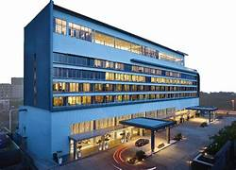
OBJECTIVE
AtliQ is a company that owns multiple hotel chains across various cities of India
The Managing director / CEO of AtliQ wants to incorporate ‘Business and Data Intelligence’ to identify and track the source of revenue for AtliQ hotels
Hence, it is decided to develop a KPI Dashboard for AtliQ, using May-22 to July-22 data, which can help track its revenue sources and other relevant KPIs across various dimensions
It’ll help the management take strategic business decisions based on the insights generated from the dashboard

Slide 3
AtliQ
Bangalore
Delhi
Atliq Bay
Atliq Blu
Atliq City
Atliq Exotica
Atliq Grands
Atliq Palace
Mumbai
Hyderabad
Atliq Bay
Atliq Blu
Atliq City
Atliq Grands
Atliq Palace
Atliq Bay
Atliq Blu
Atliq City
Atliq Exotica
Atliq Grands
Atliq Palace
Atliq Seasons
Atliq Bay
Atliq Blu
Atliq City
Atliq Exotica
Atliq Grands
Atliq Palace

Slide 4
Problem statement
Identify the data sources pertaining to revenue management
Clean and model the data as per requirement for analysis
Create a revenue dashboard that measures important KPIs
Relevant filters need to provided to slice and dice the data
The dashboard should depict both high level and granular insights

Slide 5
Solution approach
There are 5 tables provided for tracking revenue, 3 dimension tables (date, hotel, room) and 2 fact tables (bookings, aggregated bookings)
Power BI was the tool used for creating the visualization/dashboard
The data was imported, analysed and transformed as per necessity within Power Query
The relationships between the tables were created within Power Pivot

Slide 6
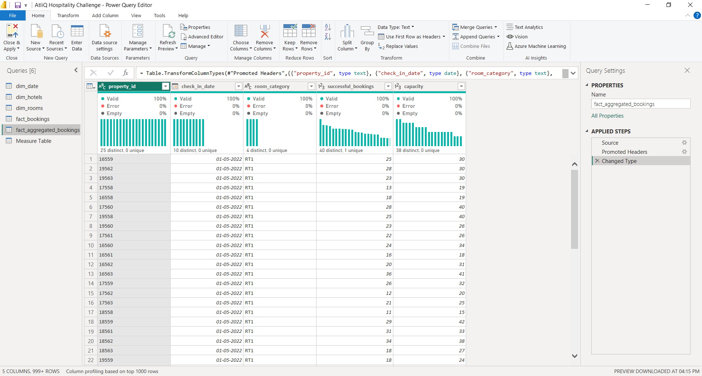
Data cleaning/transformation in Power Query

Slide 7
Solution approach
A few measures were created to calculate the KPIs as shown below:
Revenue = Sum of revenue_realized from Bookings table (in Rs.)
Total bookings = Count of booking_id from Bookings table
Avg rating = Average of ratings from Bookings table
Total capacity = Sum of capacity from Aggregated bookings table
Total successful bookings = Sum of successful bookings from Aggregated bookings table

Slide 8
Occupancy rate = Total successful bookings / Total capacity (in %)
Total cancelled bookings = Count of booking_id with status=‘cancelled’ from Bookings table
Cancellation rate = Total cancelled bookings / Total bookings (in %)
Avg stay duration = Average days stayed by customer in a room per booking

Slide 9
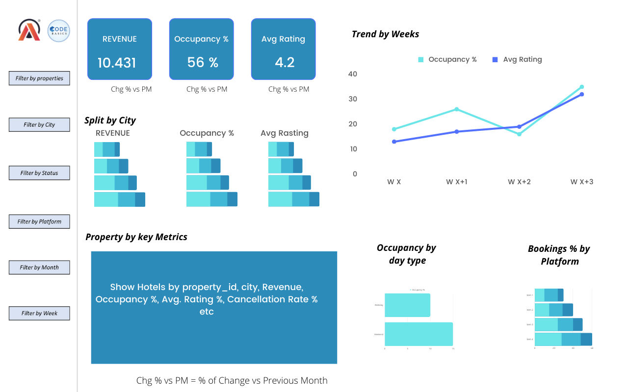
Mock-up Dashboard

Slide 10
Expected outcome after this analysis?
Regain their market share in the luxury/business hotels category.
Understanding the revenue trend by week/month/day
To get insights where business is failing and what can be done to tackle them

Slide 11
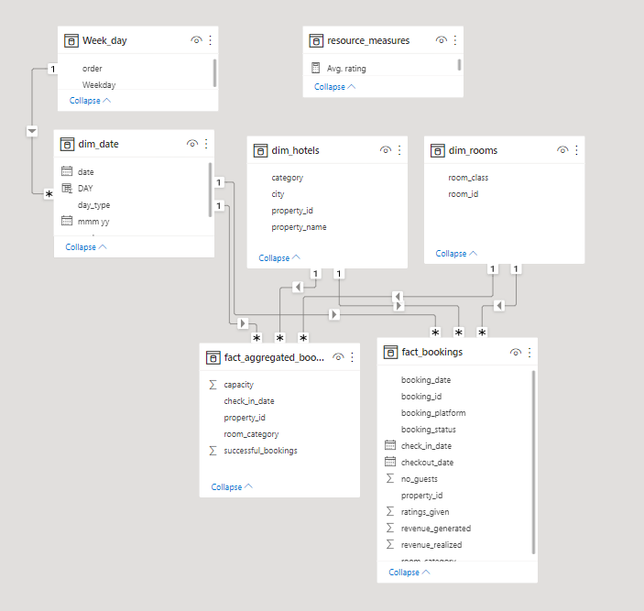
Data Model

Slide 12
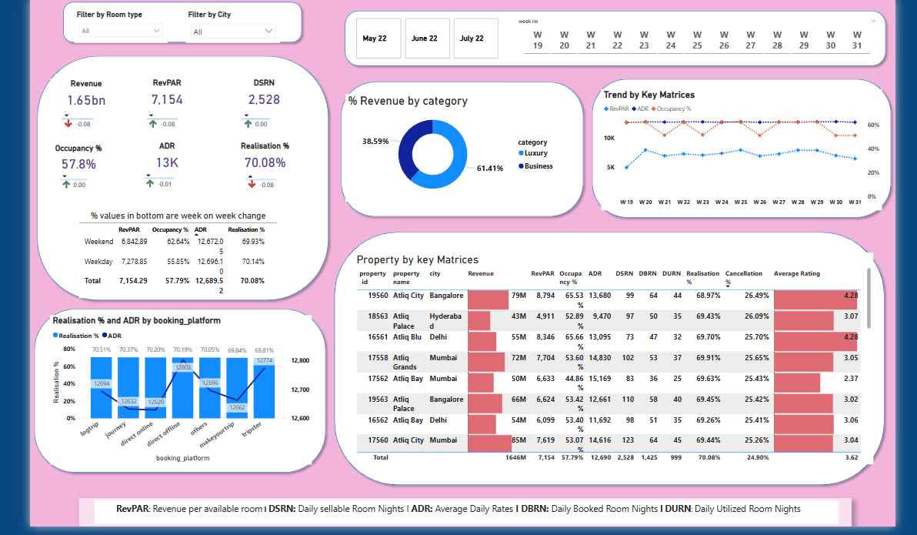
REVENUE DASHBOARD

Slide 13


